Slide 1
Unit 5: Software Testing and Quality Assurance
Total Hour:9hrs
Presented by
Er.Harendra Bikram Shah
Lecturer
Department of BCA
NAST

Slide 2
OUTLINES
Testing Techniques
Unit testing, integration testing, and system testing.
Black-box and white-box testing techniques.
Verification and Validation
The importance of software testing in the development life cycle.
Software Quality Assurance (SQA)
Overview of software quality standards (ISO, CMM).
Importance of software quality assurance (SQA) processes.
Risk Categories, The RMM Plan

Slide 3
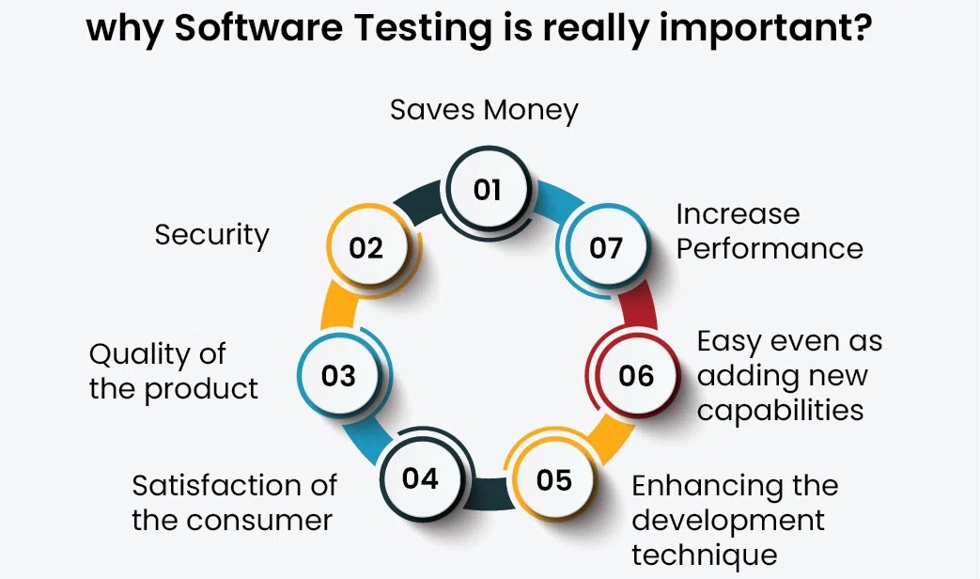
INTRODUCTION

Slide 4
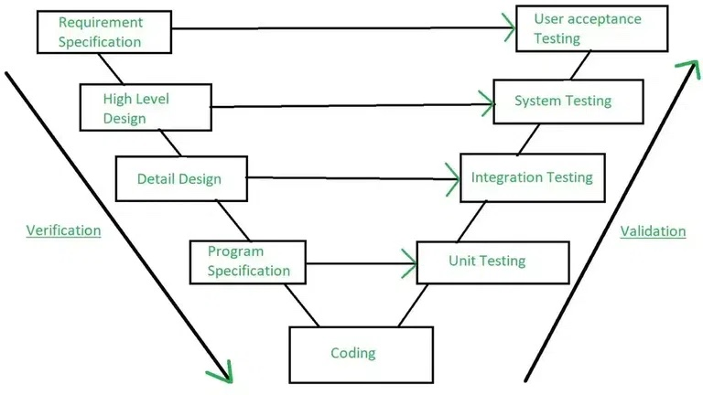
VERIFICATION and VALIDATION

Slide 5
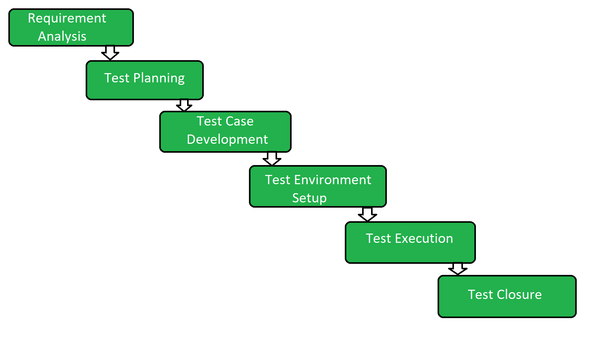
TESTING PHASES

Slide 6
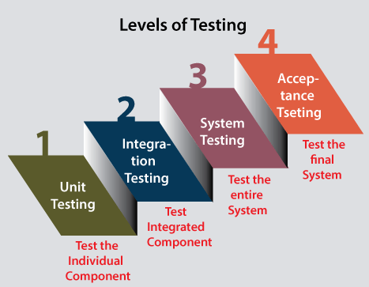

Slide 7
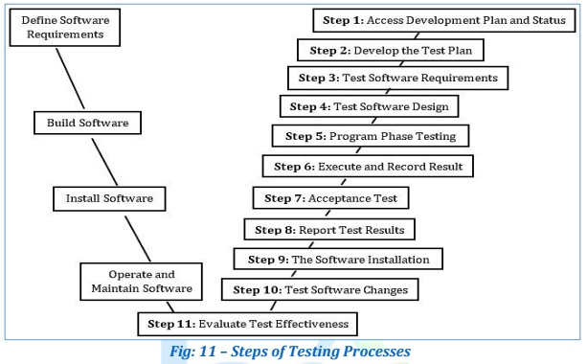
11 STEPS OF TESTING PROCESS

Slide 8
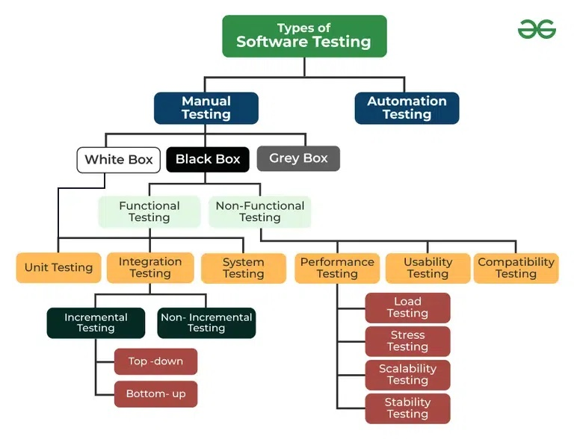

Slide 9
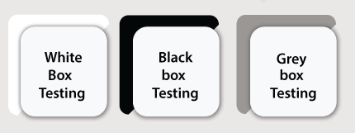
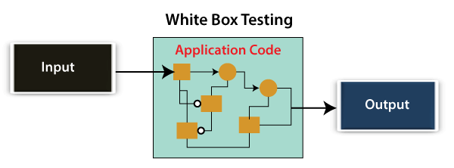
DIFFERENT TYPES OF MANUAL TESTING
White Box Testing
Developer will inspect every line of code before handing it over to the testing team or the concerned test engineers.
White box testing is also known as open box testing, glass box testing, structural testing, clear box testing, and transparent box testing.

Slide 10
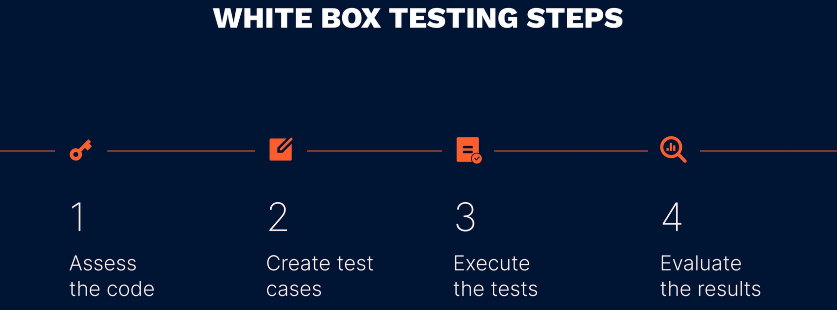
STEPS IN WHITE BOX TESTING

Slide 11
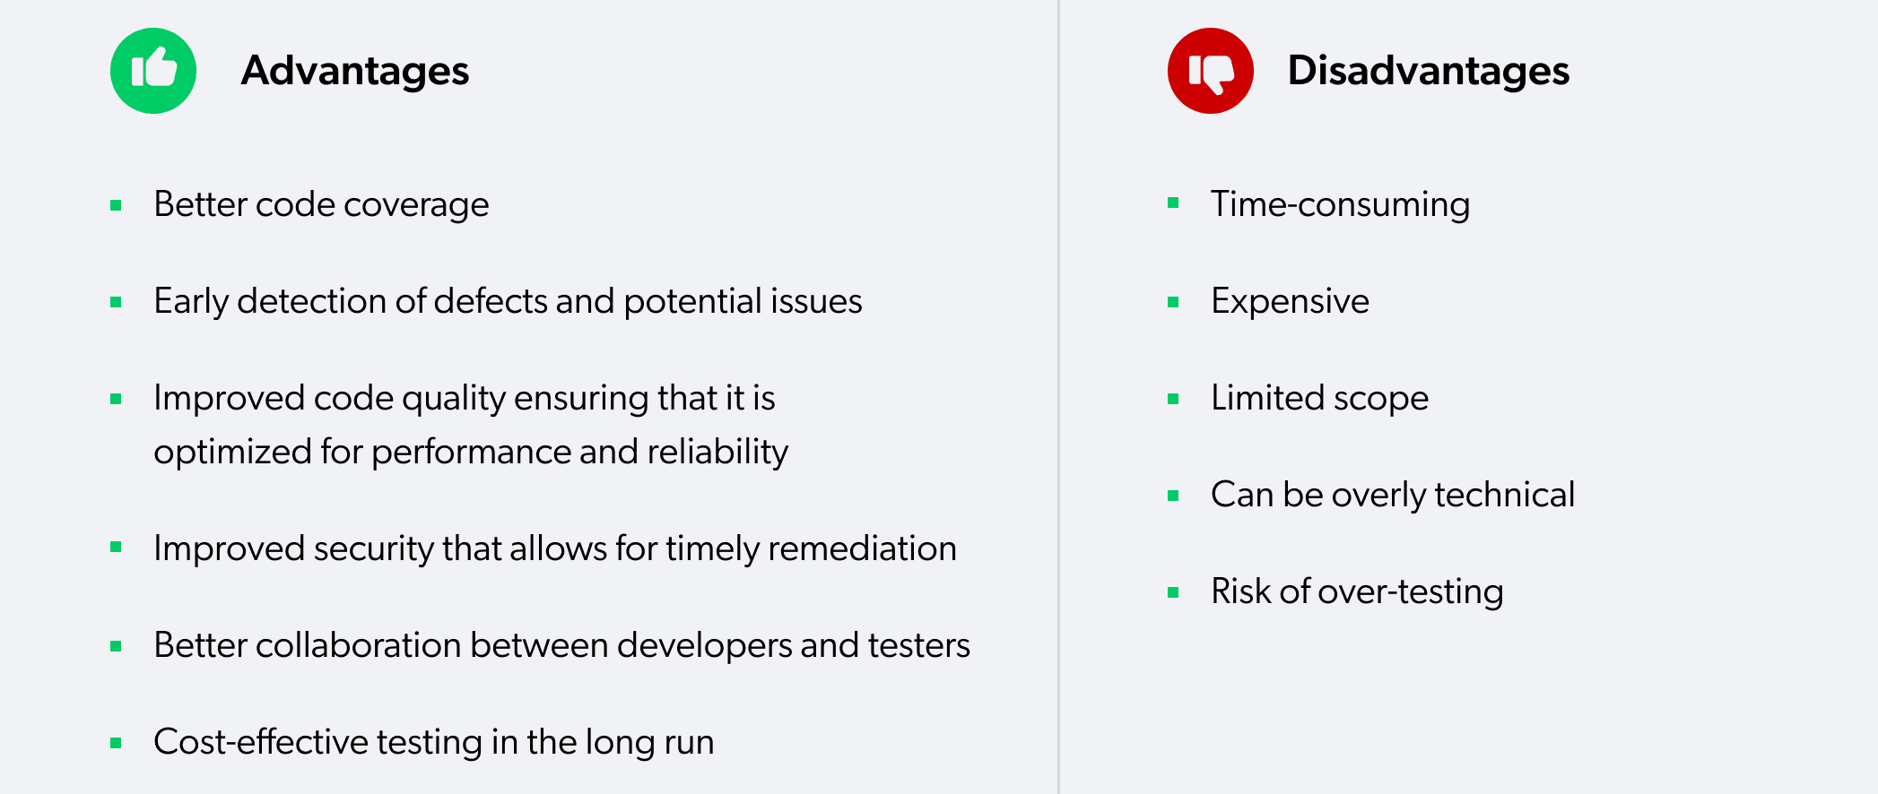
White Box Testing

Slide 12
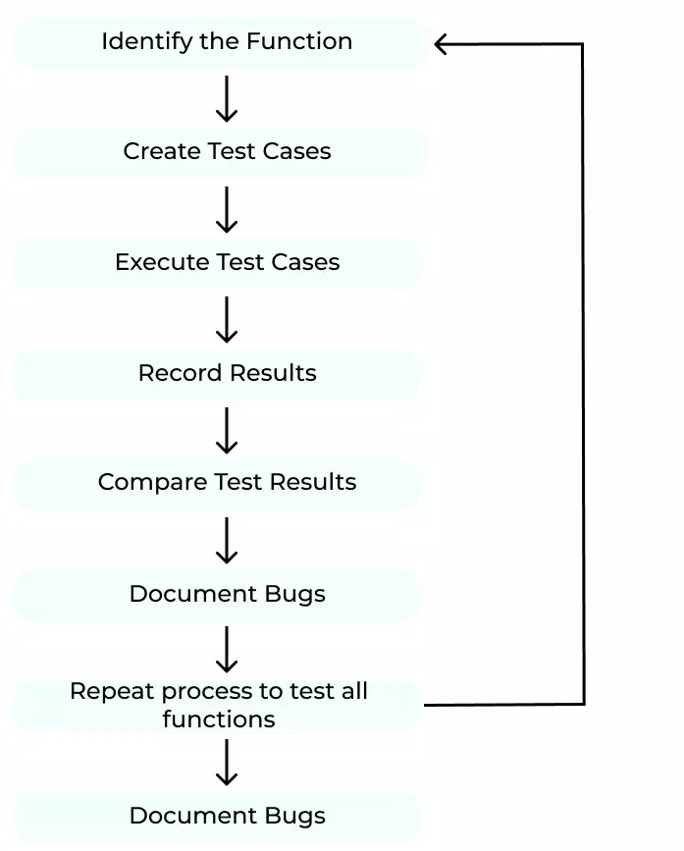
STEPS IN BLACK BOX TESTING

Slide 13
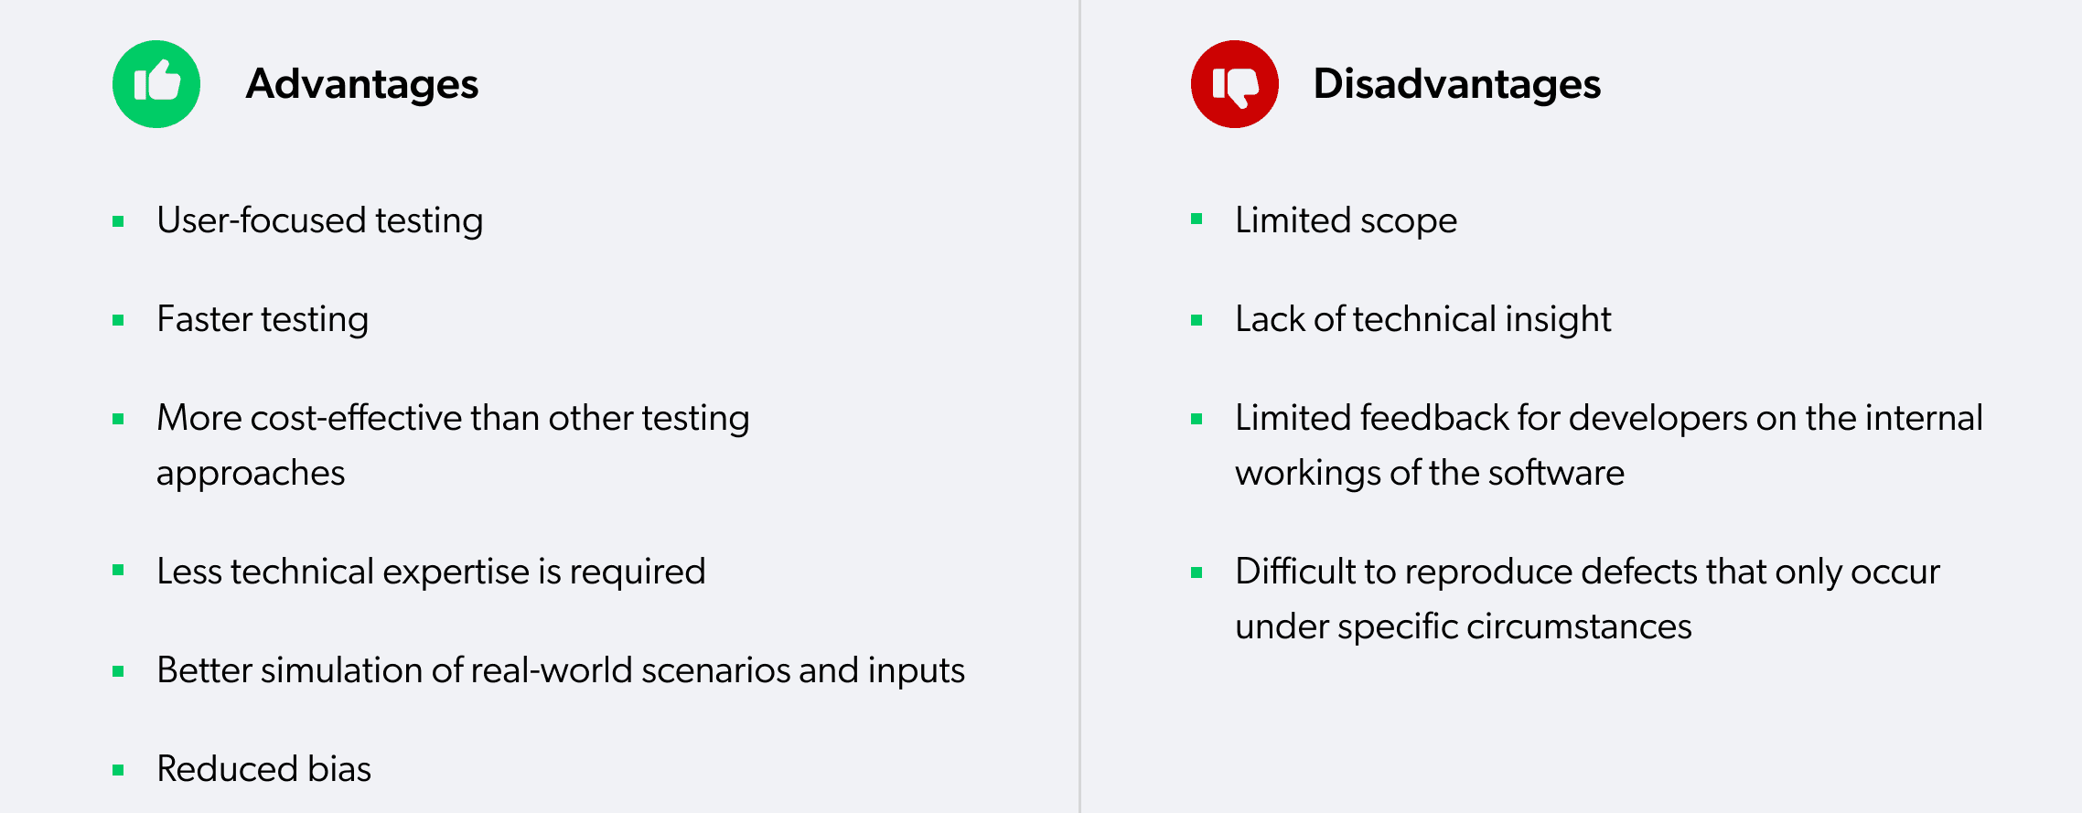
BLACK BOX TESTING

Slide 14
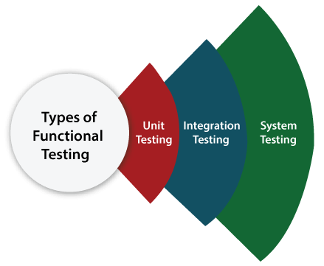
Types of Black Box Testing
Functional Testing
Non-function Testing
Functional Testing
check all the components systematically against requirement specifications is known as functional testing.
Functional testing is also known as Component testing.

Slide 15
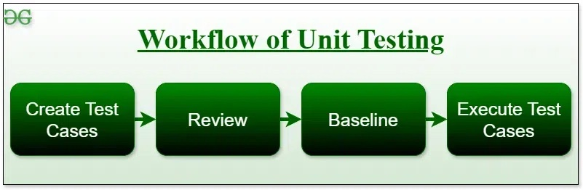
UNIT TESTING
software testing technique using individual units of software.
Unit Testing is defined as a type of software testing where individual components of a software are tested.
Objective of Unit Testing
To isolate a section of code.
To verify the correctness of the code.
To test every function and procedure.
To fix bugs early in the development cycle and to save costs.
To help the developers understand the code base and enable them to make changes quickly.
To help with code reuse.

Slide 16
UNIT TESTING
Unit Testing Techniques
There are 3 types of Unit Testing Techniques.
Black Box Testing: This testing technique is used in covering the unit tests for input, user interface, and output parts.
White Box Testing: This technique is used in testing the functional behavior of the system by giving the input.
Gray Box Testing: used in executing the relevant test cases, test methods, and test functions, and analyzing the code performance
Unit Testing Tools
Jtest
Junit
NUnit
EMMA
PHPUnit

Slide 17
UNIT TESTING
Advantages of Unit Testing
Early Detection of Issues:
Improved Code Quality:
Increased Confidence:
Faster Development:
Better Documentation:
Reduced Time and Cost:
Disadvantages of Unit Testing
Time and Effort:
Dependence on Developers:
Difficulty in Testing Complex Units:
Difficulty in Testing Interactions:
Difficulty in Testing User Interfaces:
Over-reliance on Automation:

Slide 18
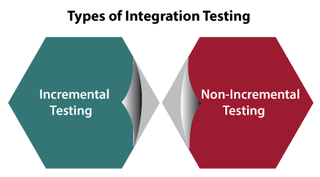
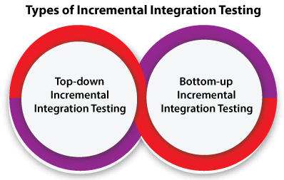

Slide 19
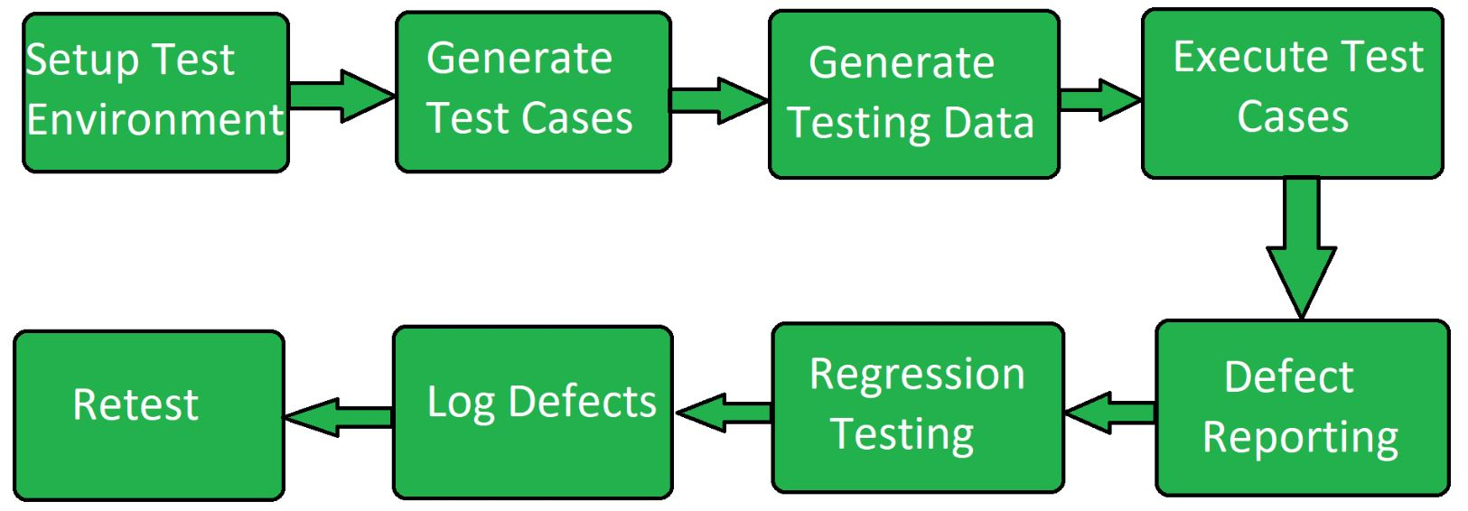
SYSTEM TESTING
series of different type of tests with the purpose to exercise and examine the full working of an integrated software computer system against requirements
includes testing of a fully integrated software system.
To check the end-to-end flow of an application or the software as a user is known as System testing.
System Testing Process

Slide 20
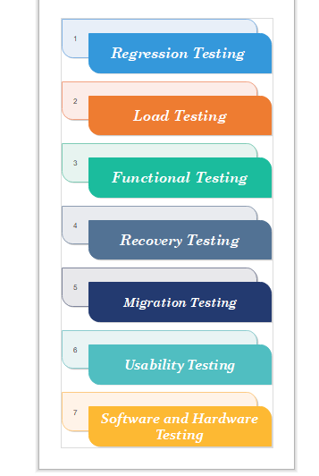
TYPES OF SYSTEM TESTING

Slide 21
TYPES OF SYSTEM TESTING
Regression testing:
It is performed under system testing to confirm and identify that if there's any defect in the system due to modification in any other part of the system.
2. Load Testing
Load testing is performed under system testing to clarify whether the system can work under real-time loads or not.
3. Recovery Testing
Recovery testing of a system is performed under system testing to confirm reliability, trustworthiness, accountability of the system and all are lying on recouping skills of the system.
4. Migration Testing
Migration testing is performed to ensure that if the system needs to be modified in new infrastructure so it should be modified without any issue.
5. Usability Testing
The purpose of this testing to make sure that the system is well familiar with the user and it meets its objective for what it supposed to do.
6.Functional Testing:
Type of testing that seeks to establish whether each application feature works as per the software requirements

Slide 22
TOOLS USED FOR SYSTEM TESTING
JMeter
Gallen Framework
Selenium
HP Quality Center/ALM
IBM Rational Quality Manager
Microsoft Test Manager
Selenium
Appium
LoadRunner
Gatling
JMeter
Apache JServ
SoapUI

Slide 23
PROS and CONS of SYSTEM TESTING
Advantages
It checks the overall functionality of a system
easily detects the bugs and finds defects.
helps to detect real-time bugs.
Disadvantages
time-consuming
expensive because it checks the full system.
challenging for large and complex systems.

Slide 24
NON-FUNCTIONAL TESTING
Non-functional testing is a software testing technique that checks the non-functional attributes of the system.
Major Types of Non-Functional Testing:
Performance Testing
Usability Testing
Compatibility Testing
Objectives of Non-functional Testing
Increased usability:
Reduction in production risk:
Cost Reduction:
Optimize installation:
Collect metrics:
Enhance knowledge of product:

Slide 25
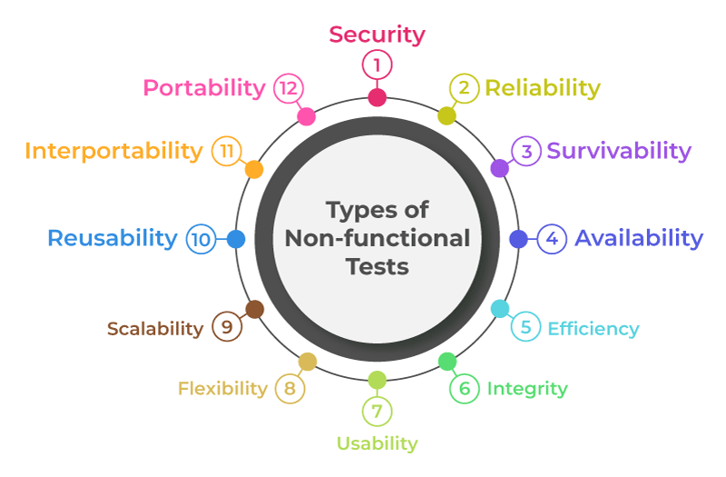
Non-functional Testing Parameters

Slide 26
Non-functional Testing Types
Performance Testing
Type of software testing that ensures software applications perform properly under their expected workload
Performance Testing Attributes:
Speed:
Scalability:
Stability:
Reliability:
Objective of Performance Testing:
To eliminate performance congestion.
To improve the product before launch in the market.
To make software rapid.
To make software stable and reliable.
To evaluate the performance and scalability

Slide 27
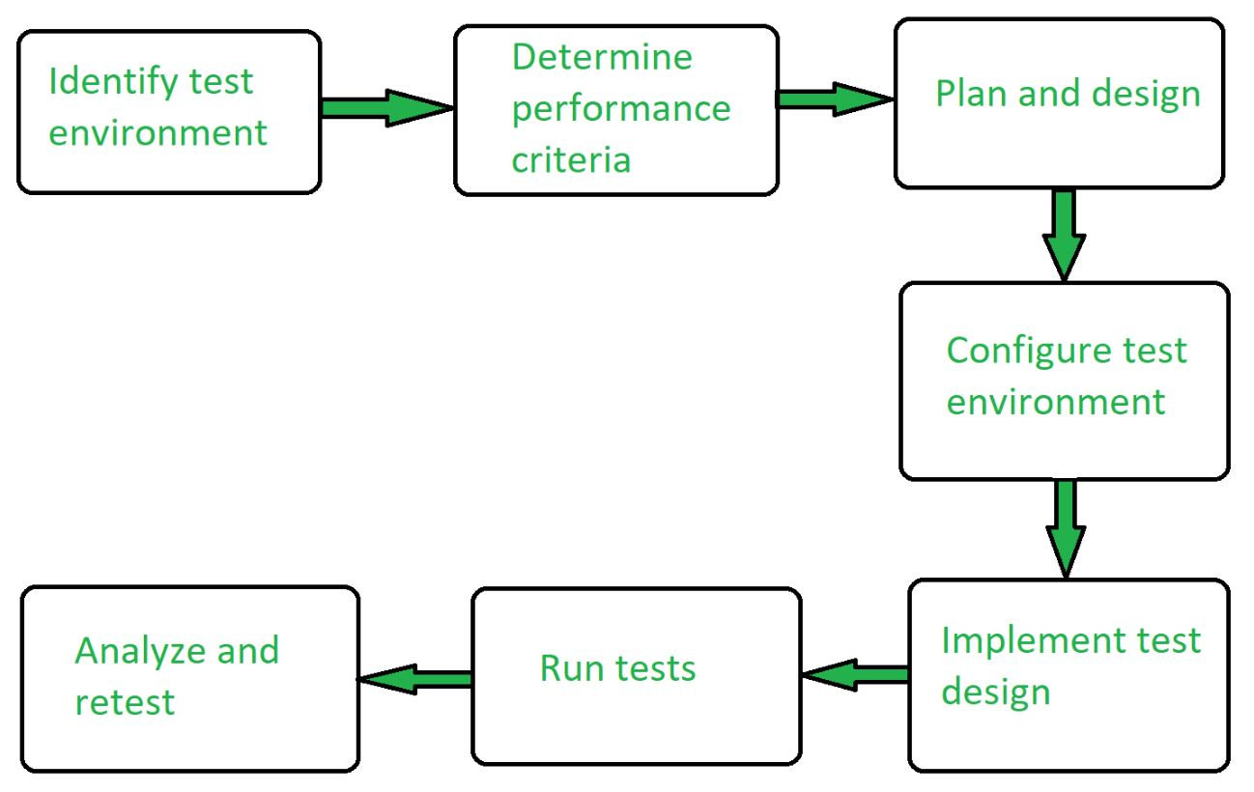
Performance Testing Process

Slide 28
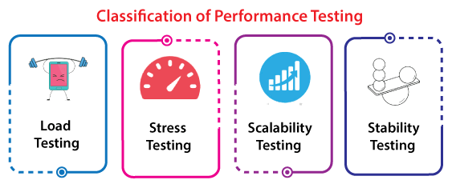
Performance Testing
Performance Testing Tools:
Jmeter
Open STA
Load Runner
Web Load
Advantages of Performance Testing :
Identifying bottlenecks:
Improved scalability:
Improved reliability:
Reduced risk:
Cost-effective:
Improved user experience:
Better Preparation:
Compliance:
Disadvantages of Performance Testing :
performance issues in the real-time environment.
high proficiency in debugging the test cases or test scripts.
Resource-intensive:
Complexity:
Limited testing scope:
Inaccurate results:
Difficulty in simulating real-world usage:
Complexity in analysing the results:

Slide 29
Performance Testing Types
Load Testing
Load testing determines the behaviour of the application when multiple users use it at the same time.
Objectives of Load Testing
Evaluation of Scalability:
Planning for Capacity:
Determine bottlenecks:
Analysis of Response Time:
Finding Memory Leaks:
Disadvantages of Load Testing
Resource-intensive:
Complexity:
Limited testing scope:
Inaccurate results:
Difficulty in simulating real-world usage:
Complexity in analysing the results:
Advantages of Load Testing
Identifying bottlenecks:
Improved scalability:
Improved reliability:
Reduced risk:
Cost-effective:
Improved user experience:

Slide 30
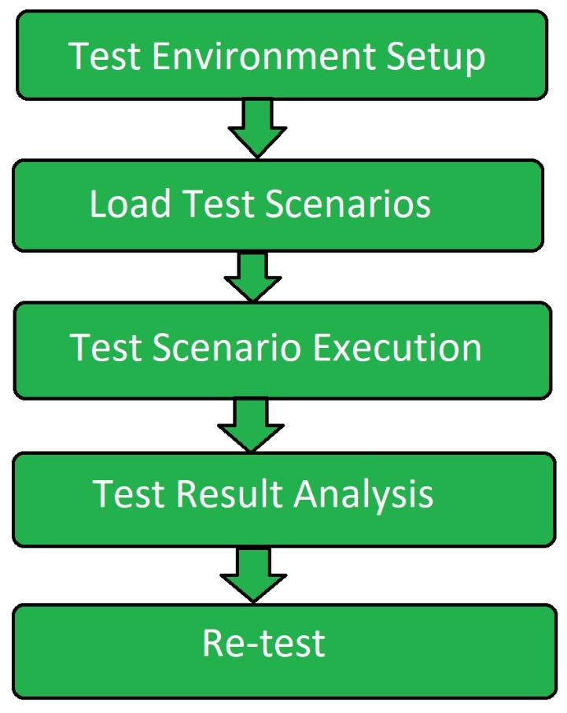
Load Testing Process

Slide 31
Stress Testing Process
software testing type that determines the robustness of software by testing beyond the limits of normal operation.
Objective of Stress Testing
Analyze the behavior of the application after failure:
System recovers after failure:
Uncover Hardware issues:
Uncover Security Weakness:
Ensures data integrity:
Benefits of Stress Testing
Determines the behavior of the system:
Ensure failure does not cause security issues:
Makes system function in every situation:
Improving Decision Making:
Increasing Stakeholder confidence:
Limitations of Stress Testing
Manual stress testing is complicated:
Good scripting knowledge required:
Need for external resources:
Constantly licensed tool:
Additional tool required in case of open-source stress testing tool:
Improper test script implementation results in wastage:

Slide 32
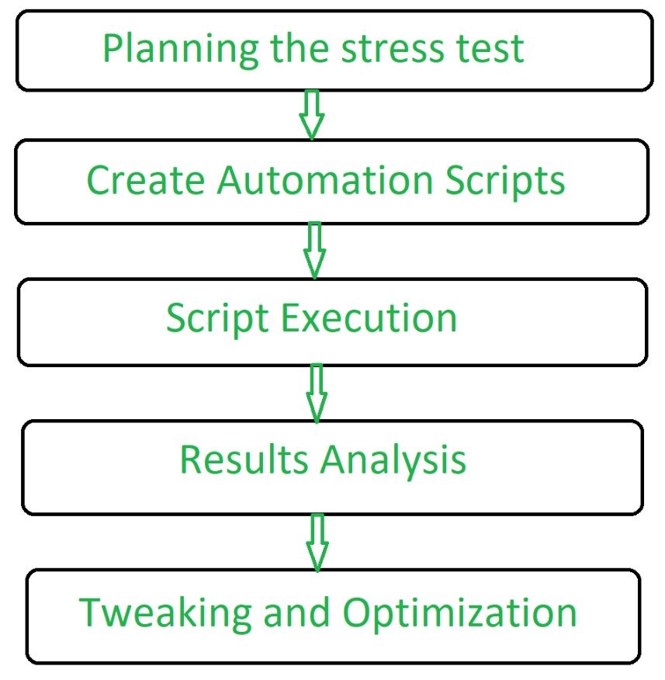
Stress Testing Process

Slide 33
Scalability Testing
Scalability Testing is defined as the ability of a network, system, application, product or a process to perform the function correctly when changes are made in the size or volume of the system to meet a growing need
Objective of Scalability Testing:
To determine how the application scales with increasing workload.
To determine the user limit for the software product.
To determine client-side degradation and end user experience under load.
To assess the system’s performance under various network circumstances,
To determine whether the system is capable of withstanding scenarios of high usage,
To guarantee that the system’s scalability
To determine server-side robustness and degradation.
To help developers improve the system design or code by pointing out bottlenecks
To evaluate the effective use of system resources
To make that the system satisfies performance criteria

Slide 34
Scalability Testing Process
Steps of Scalability Testing:
Define a process that is repeatable for executing scalability test.
Determine the criteria for scalability test.
Determine the software tools required to carry out the test.
Set the testing environment and configure the hardware required to execute a scalability test.
Create and verify visual script.
Create and verify the load test scenarios.
Execute the test.
Evaluate the result.
Generate required report.

Slide 35
Scalability Testing
Advantages of Scalability Testing:
It provides more accessibility to the product.
It detects issues with web page loading and other performance issues.
It finds and fixes the issues earlier in the product which saves a lot of time.
It ensures the end user experience under the specific load. It provides customer satisfaction.
It helps in effective tool utilization tracking.
Disadvantages of Scalability Testing:
Sometimes, it fails to find the functional errors or issues in the product.
Some automation tools used for Scalability testing is costlier
Team members involve in this testing technique should have high level of testing skills.
The time spent on testing some parts of product may consume more time than expected time.
Unexpected results may also be raised after launching the product in the customer environment.

Slide 36
Stability Testing
Type of Software Testing to check the quality and behavior of the software in different environmental parameters.
It is defined as the ability of the product to continue to function over time without failure.
Objective of the Stability Testing:
To yield confidence in the stability of the system or software application under test.
To ensure the system handling big programs.
To operate the effectiveness of the system or software application.
To check the stability of the system under stress.

Slide 37
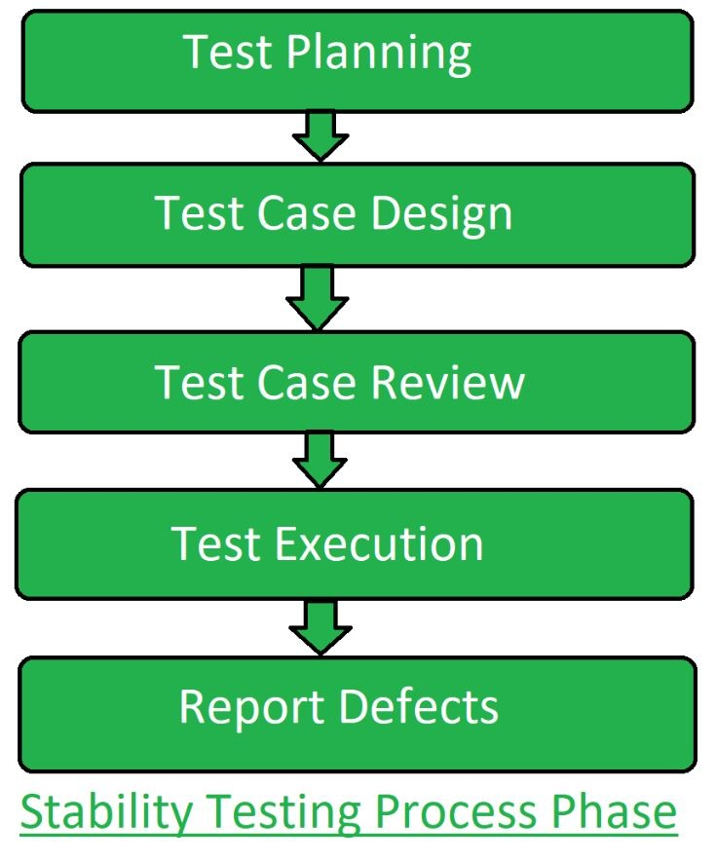
Stability Testing Process

Slide 38
Stability Testing
Advantages of Stability Testing:
It gives the limit of the data that a system can handle practically.
It provides the confidence on the performance of the system.
It determines the stability and robustness of the system under load.
Stability testing leads to a better end user experience.
Disadvantages of Stability Testing
the system might fail due to additional load on the CPU
The System fails shortly without implementing the stability testing and slows down the speed.
It works unusually when it goes to the changing environments.

Slide 39
2.Usability Testing
Checking the user-friendliness, efficiency, and accuracy of the application
features of usability testing are as follows:
Black-box testing technique in software testing.
Usability testing is performed throughout the system and acceptance testing levels.
Usability testing is implemented in the early stage of the Software Development Life Cycle (SDLC).
The execution of usability testing offers more visibility on the prospects of the end-users.
The usability testing makes sure that the software product meets its planned purpose.
It also helps us to find many usability errors in the specified software product.
tests the user-friendliness, usefulness, traceability, usability, and desirability of the final product.
It offers direct input on how real-users use the software/application.
Includes the systematic executions of the product's usability under a measured environment.

Slide 40
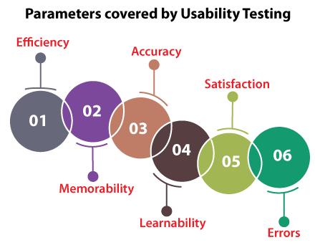
2.Usability Testing

Slide 41
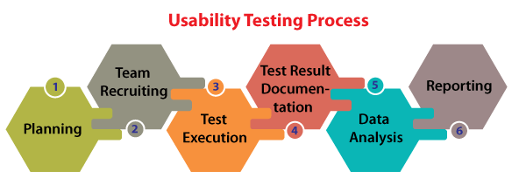

Slide 42
The Advantages of Usability Testing
Helps us to validate the usability of the software.
Its enhanced user satisfaction
Discover the usability issues before delivering the final product.
The end-user is always eager to use the application.
It improves the adequacy and consistency of the software product.
The Disadvantage of Usability Testing
Costly
harder to identify the volunteers who can work as test engineers.
Primarily, usability testing is not 100% representative of the actual condition.

Slide 43
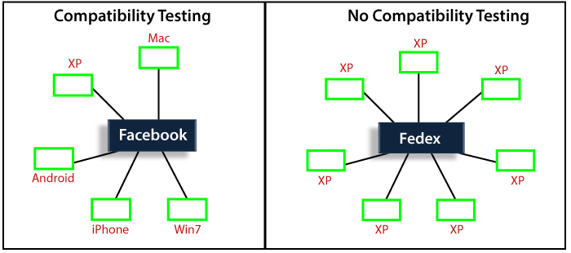
3. compatibility testing.
Checking the functionality of an application on different software, hardware platforms, network, and browsers

Slide 44
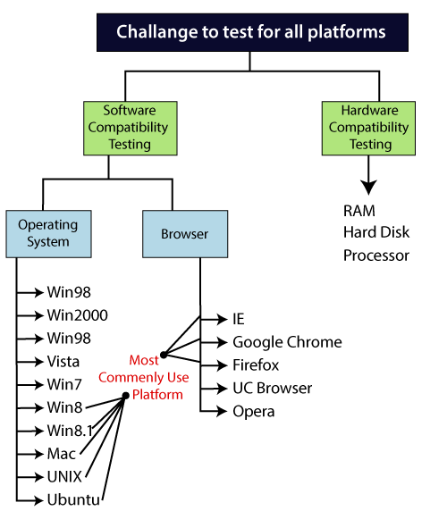
3. compatibility testing.
Types of Compatibility testing
Software
Hardware
Network
Mobile

Slide 45
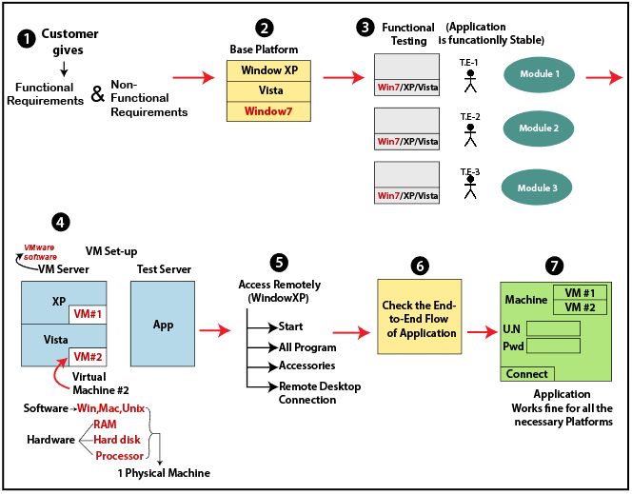
3. compatibility testing Process.

Slide 46
3. compatibility testing
Why compatibility testing is important?
It ensures complete customer satisfaction.
It provides service across multiple platforms.
Identifying bugs during development process.
Limitations
Variety of user interface.
Changes with respect to font size.
Alignment issues.
Issues related to existence of broken frames.
Issues related to overlapping of content.

Slide 47
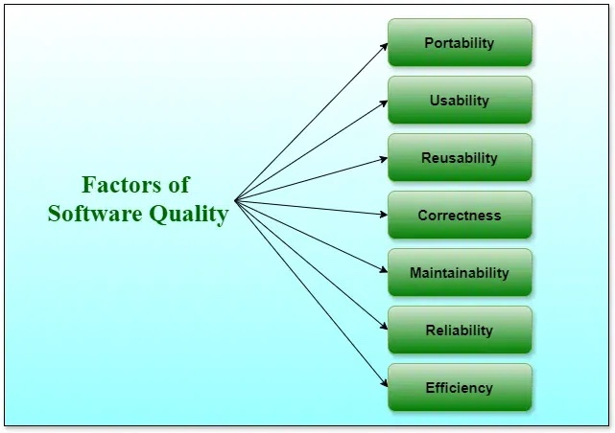
Software Quality Concepts
Software quality refers to the degree to which a software product meets specified requirements and user expectations.
Software Quality shows how good and reliable a product is

Slide 48
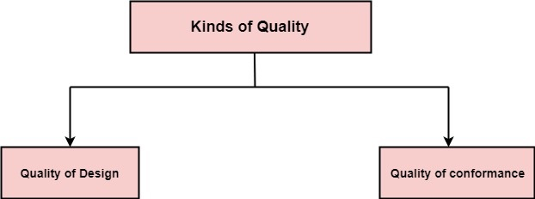
Software Quality Assurance (SQA)
Quality defines to any measurable characteristics such as correctness, maintainability, portability, testability, usability, reliability, efficiency, integrity, reusability, and interoperability.
Quality of Design: refers to the characteristics that designers specify for an item.
Quality of conformance: is the degree to which the design specifications are followed during manufacturing.

Slide 49
Software Quality Assurance (SQA)
Software quality assurance is a systematic plan of all actions necessary to provide adequate confidence that an item or product conforms to establish technical requirements.
Software Quality Assurance (SQA) is simply a way to assure quality in the software.
It is the set of activities which ensure processes, procedures as well as standards are suitable for the project and implemented correctly.
Software Quality Assurance (SQA) focuses on
software’s portability
software’s usability
software’s reusability
software’s correctness
software’s maintainability
software’s error control
Software Quality Assurance (SQA) has
A quality management approach.
Formal technical reviews.
Multi testing strategy.
Effective software engineering technology.
Measurement and reporting mechanism.

Slide 50
Major (SQA) Activities/Process
SQA Management Plan:
Set The Check Points:
Measure Change Impact:
Multi testing Strategy:
Manage Good Relations:
Maintaining records and reports :
Reviews software engineering activities :
Formalize deviation handling :

Slide 51
Benefits of Software Quality Assurance (SQA)
SQA produces high quality software.
High quality application saves time and cost.
SQA is beneficial for better reliability.
Improving the process of creating software.
Improves the quality of the software.
Disadvantage of Software Quality Assurance (SQA)
Cost:
Time Consuming:
Overhead:

Slide 52
Importance of SQA Process
1. Improves Software Quality
2. Saves Time & Cost
3. Enhances Customer Satisfaction
4. Increases Security
5. Boosts Efficiency
6. Ensures Compliance
7. Reduces Risks
8. Ensures Long-Term Success

Slide 53
Overview of software quality standards (ISO, CMM)
ISO/IEC 25000 (SQuaRE): The International Organization for Standardization (ISO) and the International Electrotechnical Commission (IEC) developed the ISO/IEC 25000 series, also known as the Software Product Quality Requirements and Evaluation (SQuaRE) standards.
ISO/IEC 9126: This standard, which has been superseded by ISO/IEC 25010, focused on software quality characteristics and metrics.
ISO/IEC 12207: The ISO/IEC 12207 standard outlines the Software Life Cycle Processes, providing guidelines for the development, maintenance, and management of software products.
CMMI (Capability Maturity Model Integration): Developed by the Software Engineering Institute (SEI) at Carnegie Mellon University, CMMI is a process improvement framework that helps organizations optimize their software development processes.
IEEE 730: This standard, titled "IEEE Standard for Software Quality Assurance Plans," provides guidelines for developing and documenting software quality assurance plans.
IEEE 1061: The "IEEE Standard for Software Quality Metrics Methodology" establishes a framework for defining and applying software quality metrics.
ISO/IEC 9000 series: While not specifically focused on software, the ISO 9000 series provides general quality management principles and guidelines that can be applied to software development processes.

Slide 54
Software quality standards
ISO Standards in Software Engineering
Different types of ISO standards :
ISO 9000: 2000: contains Quality management systems, fundamentals, and vocabulary.
ISO 9000-1: includes Quality management systems and Quality assurance standards.
ISO 9000-2:includes Quality management systems and Quality assurance standards.
ISO 9000-3:contains Quality management systems, Quality assurance standards and also includes guidelines
ISO 9001: has Quality systems and a Quality assurance model.
ISO 9001: includes Quality management systems.
ISO 9002: includes some Quality systems.
ISO 9003: Includes some Quality systems.
ISO 9004: Include some Quality management systems.
ISO 9039: include some Optics and Optical Instruments.
ISO/IEC 9126-1:Includes some software products, quality models.
ISO/IEC 9040:Includes open system interconnection and Virtual terminal basic class service.
ISO/IEC 9041-1: Includes open system interconnection, Virtual terminal basic class service protocol
ISO/IEC 9041-2: Include information technology, open system interconnection, Virtual terminal basic class
ISO/IEC 9075-9: Has information technology, Database languages, and SQL/MED
ISO/IEC 9075-10: Has information technology, Database languages, and SQL/OLB (Object Language Bindings).
ISO/IEC 9075-13: has information technology, Database languages, SQL routines, and Java Programming

Slide 55
SEI [Software Engineering Institute] Software quality standards
1.Capability Maturity Model Integration (CMMI):
CMMI is one of the most well-known and widely adopted SEI standards.
It provides a framework for organizations to assess and improve their software development processes.
2. Capability Maturity Model (CMM):
predecessors to CMMI used for assessing and improving software development processes
3.Team Software Process (TSP):
framework for building high-performance teams and managing the development of software-intensive systems.
TSP emphasizes disciplined team-based practices and focuses on improving both individual and team performance throughout the software development lifecycle.
4. Personal Software Process (PSP):
(PSP) is a set of software engineering practices designed to help individual developers improve their personal productivity and software quality.
PSP provides developers with a structured approach to planning, tracking, and managing their work, with an emphasis on defect prevention and measurement.
5. Software Product Line Engineering (SPLE):
(SPLE) is an approach to software development that emphasizes systematic reuse of software assets across multiple products within a product line.

Slide 56
Software Risk Management
focuses specifically on identifying, assessing, and mitigating risks associated with developing, deploying, and maintaining software systems.
There are mainly 3 classes/ Categories of risks that may affect a computer code project:
Project Risks:
Technical Risks:
Business Risks:
Benefits of risk management
Helps protect against potential losses.
Improves decision-making by considering risks.
Reduces unexpected expenses.
Builds resilience against unexpected challenges.
Limitation of Risk Management
Too much focus on risk can lead to missed opportunities.
Implementing risk management can be expensive.
Risk models can be overly complex and hard to understand.
Managing risks can take a lot of time and resources.

Slide 57
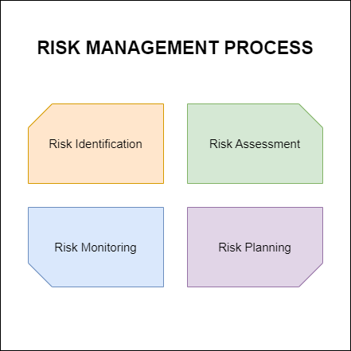
Software Risk Management

Slide 58
The RMMM plan
Risk Mitigation : It is an activity used to avoid problems (Risk Avoidance). Steps for mitigating the risks as follows.
Finding out the risk.
Removing causes that are the reason for risk creation.
Controlling the corresponding documents from time to time.
Conducting timely reviews to speed up the work.
Risk Monitoring : It is an activity used for project tracking. It has the following primary objectives as follows.
To check if predicted risks occur or not.
To ensure proper application of risk aversion steps defined for risk.
To collect data for future risk analysis.
To allocate what problems are caused by which risks throughout the project.

Slide 59
The RMMM plan
Risk Management and planning :
It assumes that the mitigation activity failed and the risk is a reality.
This task is done by Project manager when risk becomes reality and causes severe problems.
If the project manager effectively uses project mitigation to remove risks successfully then it is easier to manage the risks.
This shows that the response that will be taken for each risk by a manager.
The main objective of the risk management plan is the risk register.
This risk register describes and focuses on the predicted threats to a software project.
Drawbacks of RMMM
It raises the cost of the project.
Time will be needed more.
A larger project's implementation of an RMMM could prove to be a time-consuming process in and of itself.
RMMM cannot guarantee a project will be risk-free; in fact, hazards could materialise after the project has been delivered.
Not All Organisations Should Use RMMM.
Data security is an issue for RMMM.
Focus Loss from Automation

Slide 60
END OF THE UNIT

Slide 61
THANK YOU

